Slide 1


Providence Health and Services
Open Source Skeletal Patient Centered-Website

Slide 2
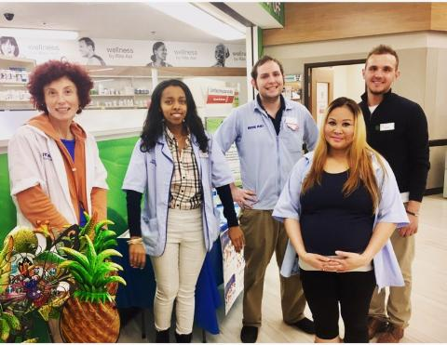
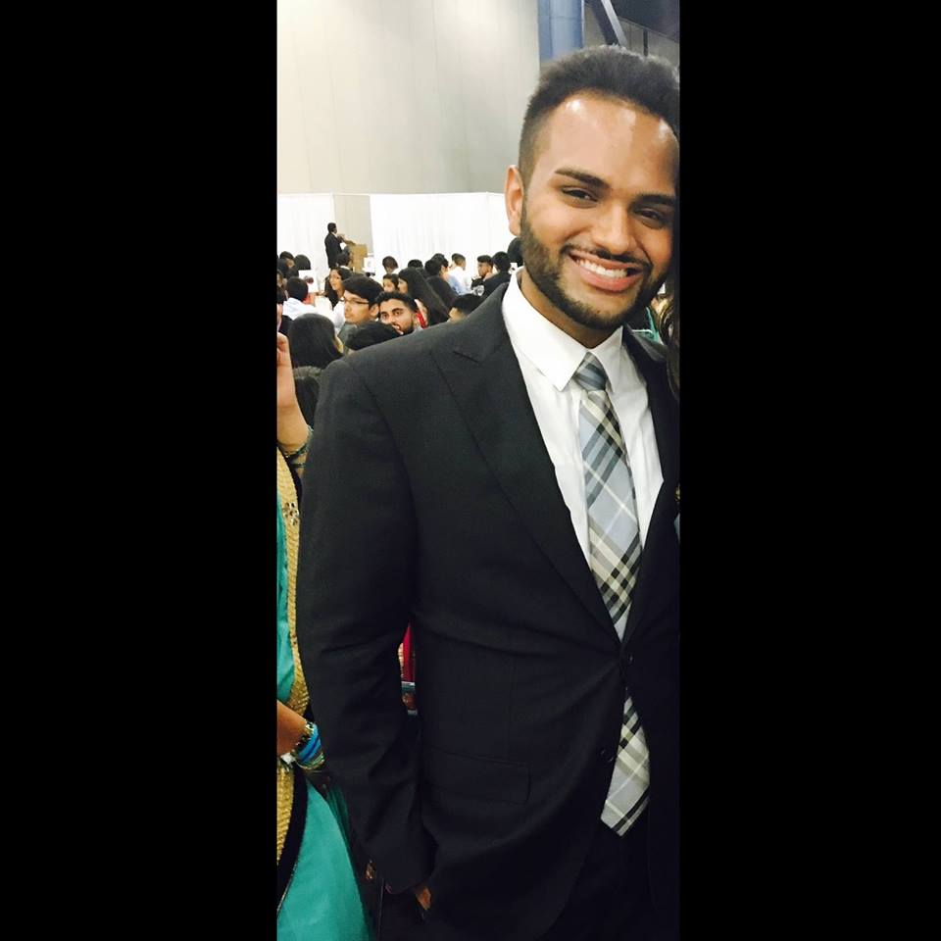
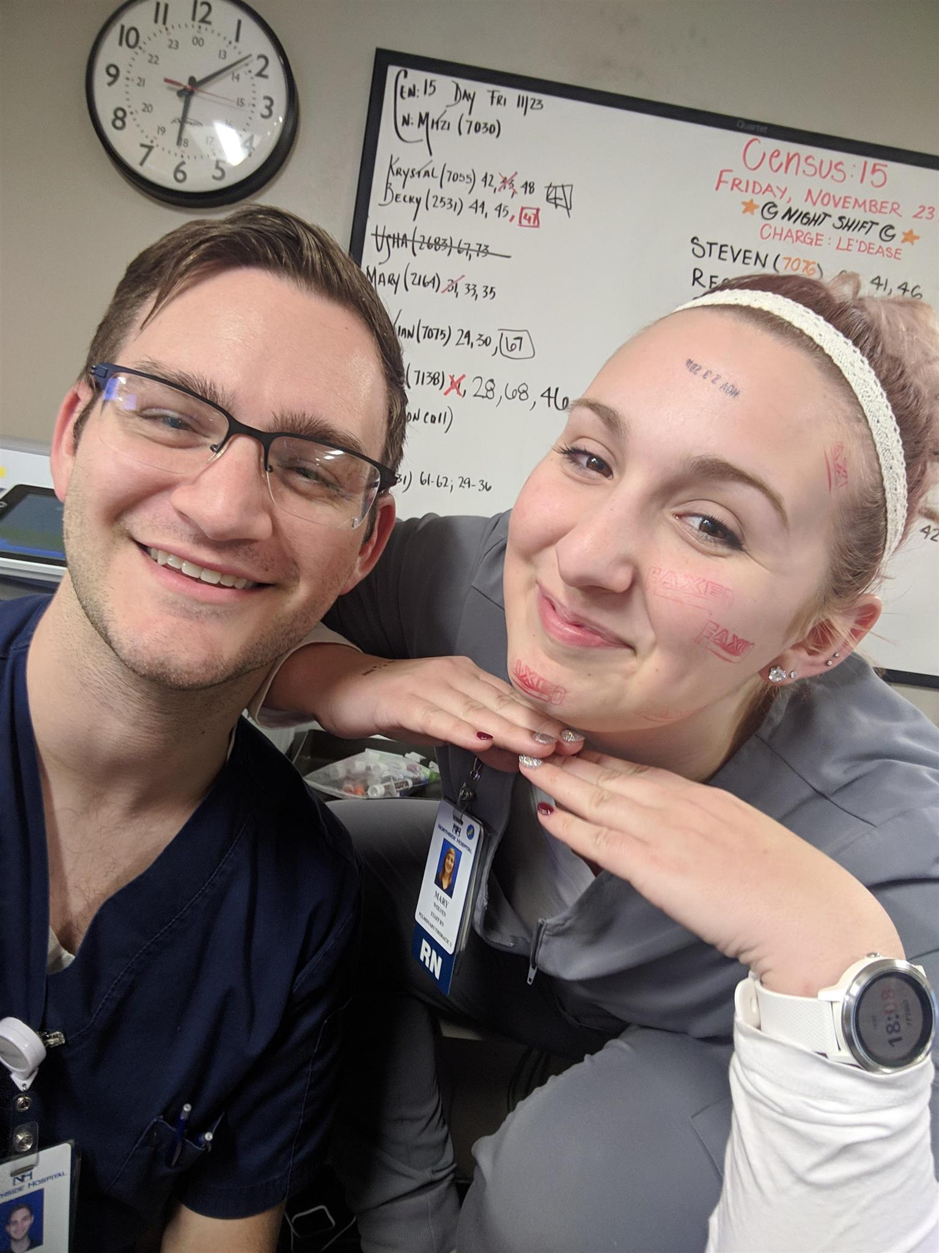
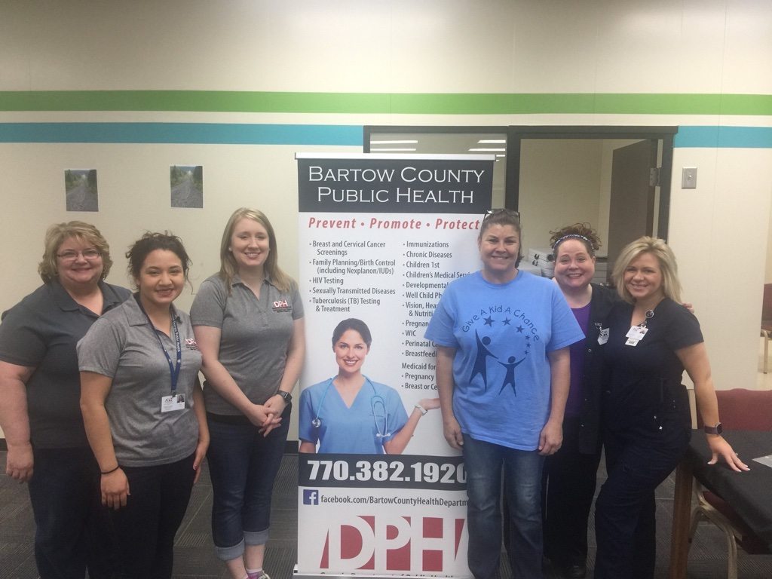
Motivation

Slide 3

Motivation
We all have worked in the healthcare setting whether it be a primary care, in a nursing unit, pharmacy, or as a clinician. This has inspired us to use what we learned in class and attending python events to build a healthcare website.
We would like to create an open source skeleton healthcare website using Flask tool and incorporate user friendly features such as YouTube, cognitive games, and Spotify API that enhance the physician's ability to access patients.
We realized the use of python in patient care and pharmacy management this inspired us to build a website that enhances patient-centered healthcare delivery.

Slide 4

Game Plan
This online skeletal website provides patients and users the ability to find resources and expand their knowledge regarding hospital services including the ability to play educational videos, cognitive games, and music online.

Slide 5
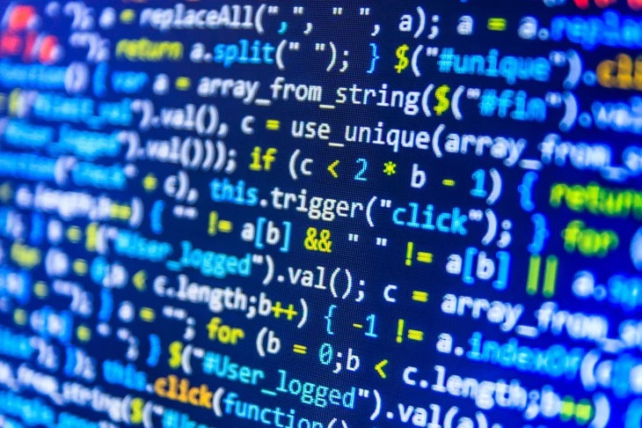
Codes
FRONT END
HTML (Hypertext Mark-up Language)
CSS (Cascading Style Sheets)
JAVASCRIPT
BACK END
PYTHON
QUERY Language
FLASK

Slide 6

Patient Education: YouTube
I helped to make the website functional by indexing the html files into templates and also made the background images pull from a static folder on the hardware rather than a website.
Additionally, my contribution to the patient portal is the video viewer. Although the app looks simple, it was actually very difficult to make functional. I feel like I learned a great deal about flask, python, html, and css.
The most challenging part of the project was to make the YouTube function so that I could pull in other videos based on their video ID's.

Slide 7

Patient Education: Game
Issues
Installing Pygame – had issues – YouTube helped.
First game modified was a Python game – unable to make work
Tried to modify a HTML game – unable to make work
Third game – worked – but very simple
Getting Flask to work on my computer to visualize changes

Slide 8
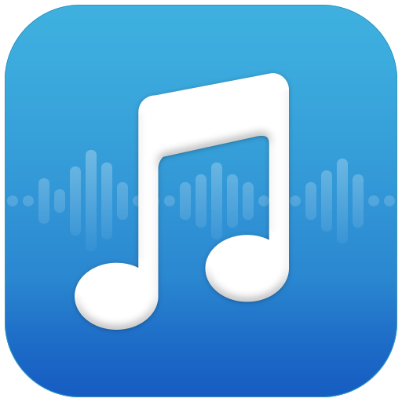
Patient Education: Music Player
Music is use to help sooth the patient mind when it comes to them in a healthcare setting.
I was becoming really frustrated with not finding a code. I was going to give up hope, but then I remember a way to create one. I found a HTML code that would work in Flask.
It was able to play music from a link that I was able to obtain from YouTube. At last, I was able to see a light at the end of the tunnel.

Slide 9

The End

